Slide 1
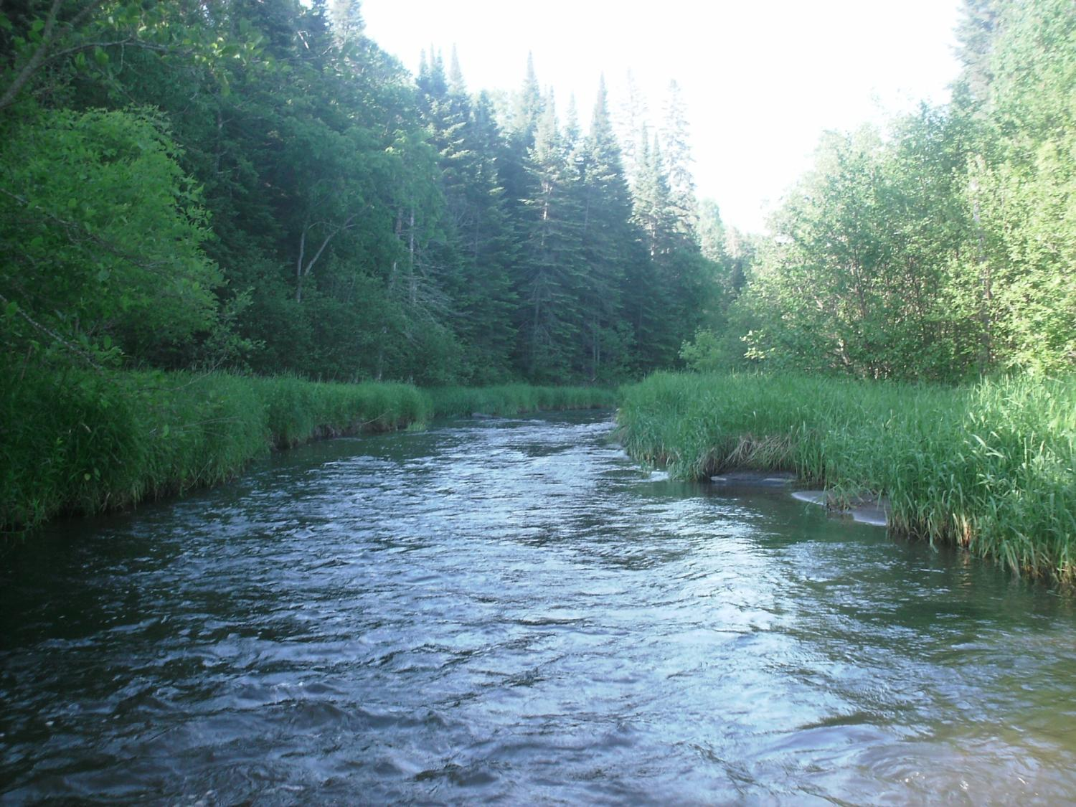
Legislative Water Commission
2019 Recommendation Feedback
Keeping Water on the Land—
Water Retention
Co-chairs: Senator Wiger Representative Torkelson
Jim Stark, Director
Straight River, Becker County
1

Slide 2
Introductions
LWC members
Legislators
Kris Van Amber
Kasey Gerkovich
Jim Stark
2

Slide 3
Legislative Water Commission
REVIEW-state agencies’ water policy reports & recommendations
GATHER- data and comments
LEGISLATIVE RECOMMENDATIONS: Assist legislature in formulating legislation
SHARE-data & information with LCCMR, CWC, legislative standing committees, upon request
COORDINATE-with the CWC

Slide 4
How can the recommendations be used?
Propose/promote/support legislation
Resource for stakeholders regarding legislative initiatives
Recommendations to guide or suggests programs/planning/funding:
  LCCMR
  CWC
  Agencies

Slide 5
LWC: 12 Members
Body | First Name | Last Name | Party | District | Home
Sen | Paul | Anderson | R | 44 | Plymouth
Rep | David | Bly | DFL | 20B | Northfield
Sen | Rich | Draheim | R |  | Madison Lake
Sen | Kent | Eken | DFL | 4 | Twin Valley
Rep | Peter | Fischer | DFL | 43A | Maplewood
Rep | Glenn | Gruenhagen | R | 18B | Glencoe
Sen | Jason | Isaacson | DFL | 19A | Shoreview
Rep | Clark | Johnson | DFL | 19A | N. Mankato
Rep | John | Poston | R | 9A | Lake Shore
Rep | Paul | Torkelson* | R | 16B | Hanska
Sen | Bill | Weber | R | 22 | Luverne
Sen | Chuck | Wiger* | DFL | 43 | Maplewood

Slide 6
Agenda
  2018 Process
  2019 Process
    Overview of possible 2019 Issues
    Describe Today’s Issue
    Small Group Review/Report
    Next Steps

Slide 7
2019 Recommendations
  Six Issues with recommendations:
  Based on:
    2018 session process
    LWC guidance
    Stakeholder advice
    Review of many plans/documents

Slide 8
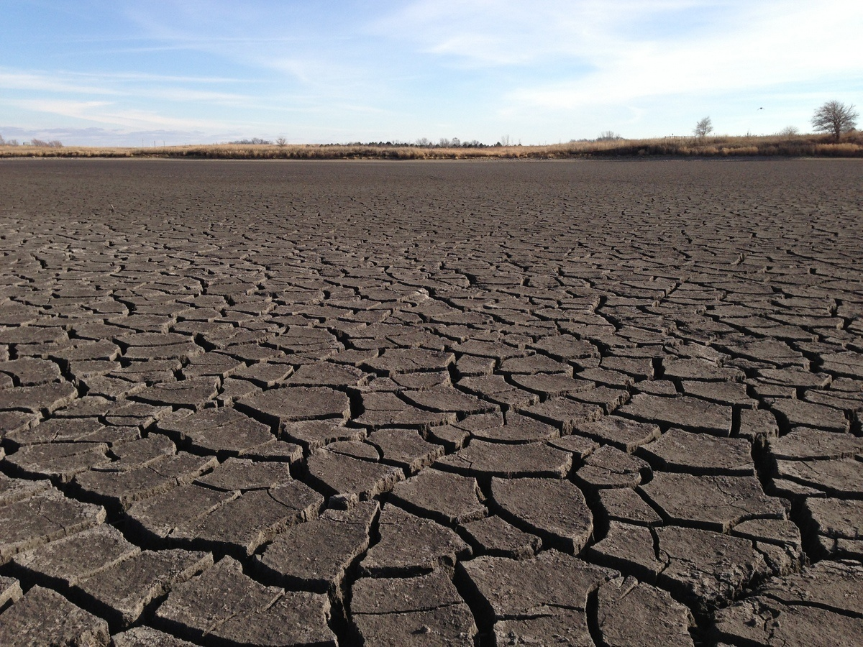
A Firm Foundation
1989- GW Act
1999- USGS Sustainability Report
2004- G16 Impaired Waters Plan (MPCA)
2005- DNR/GW Report
2006- Clean Water Legacy Act
2006- ENRTF Sustainability Report
2008- Clean Water Amendment
2008 Legislative Water Sustainability Framework
2009- EQB Sustainability Report
2012- GW Management Area Plans (DNR)
2017- Freshwater Society Reports on Water Sustainability
(Worthington, MN-2012)

Slide 9
Six Issue Areas
9

Slide 10
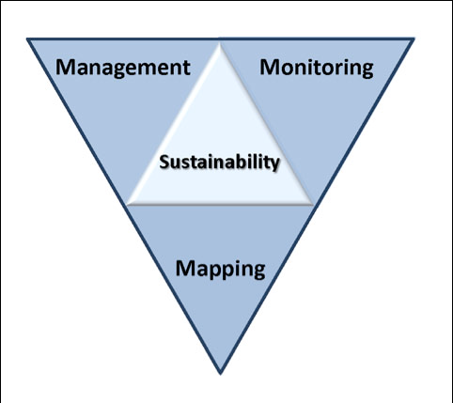
2019 LWC Issues and Recommendations
Wastewater*
Drinking water*
Groundwater
Sustainable Lakes
Water retention
Future state
* Short term
Notes:
Protection of ground water and surface water resources will require substantial investments from a diversity of funding sources over all levels of government during the next decade. As a part of this effort, this program of mapping, monitoring and managing is necessary to deliver the basic understanding of the hydrologic system for both surface and groundwater.

Slide 11
Today’s Issue
11

Slide 12
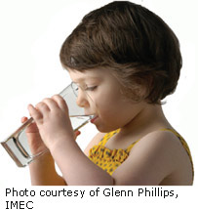
Keeping Water on the Land-
Water Retention
Important issue:
Urban and agricultural drainage have been essential to growth and development
Much or the state is affected
Drainage has many benefits
Many environmental impacts
BMP’s can reduce impacts
Need a better strategic plan for BMP placement- type and location
Provide assistance/incentives to promote conservation and agricultural productivity and in the right places
Notes:
What we hope to leave you with is a much better understanding of our state’s groundwater resources and appreciation for the challenges we face.
Simply stated the problem we are increasingly recognizing is that there are ….

Slide 13
Recommendations: Keeping Water on the Land
Map subsurface drainage
ROI on drainage BMPs
“Drainage Working Group” for all BMPs
Map and replace open tile inlets
Quantify impact of tile drainage on GW
Quantify effects urban water retention on GW
Quantify effects of drainage on water balances
Identify appropriate watershed locations for BMPs
1Watershed/1 Plan approach for siting BMPs

Slide 14
Recommendations: Keeping Water on the Land-2
10. Evaluate drainage impacts on wetlands
11. Assess emerging contaminant threats in urban storm water ponds
12. Healthy soil/healthy water initiatives
13 Support recommendation of the Drainage WG
14 Quantify/protect aquifer recharge in drained areas
15. Maintain and upgrade rural culverts and ditches
16– Missing recommendations**

Slide 15
  Today’s Request:
  Small groups
  Review issues/recommendations
  Missing issues?
  Missing stakeholders?
  Rank issues (H/L)
  Seeking your input--not consensus
  Will revisit issues later
15

Slide 16
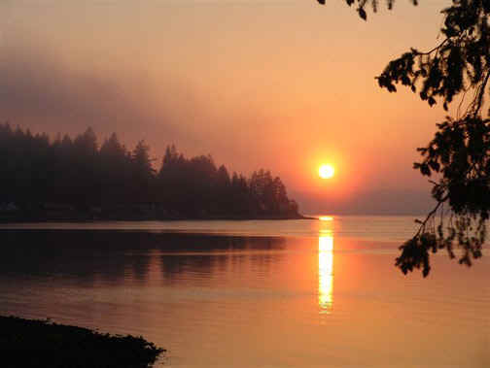
Resources:
Recommendations
Background issue paper- draft
Notes:
For more information and real time monitoring data you can visit this web site.

Slide 17
Small Group Exercise
  Discuss recommendations
  What’s missing?
  Who’s missing?
  Rank (H,L)
  Are they actionable- Move the needle?
  Appropriate for Legislation/ Funding/Agency or Stakeholder Resource?
  Consensus
  Report back:
  Top issues (1-2) and missing issue
  40 minutes
Notes:
For more information and real time monitoring data you can visit this web site.

Slide 18
Next Steps
  Complete Issue papers
  Revise recommendations based on your input
  Feedback from LWC Members
  Additional Feedback from Stakeholders
  Final consensus by LWC
  Recommendations to Legislature- before session
  Legislative Briefings with Committees

Slide 19
Small Group Exercise
  Discuss recommendations
  What’s missing?
  Who’s missing?
  Rank (H,M,L)
  Are they actionable- Move the needle?
  Appropriate for Legislation/ Funding/Agency or Stakeholder Resource?
  Report back:
  Top issue and most important missing issue
  40 minutes
Notes:
For more information and real time monitoring data you can visit this web site.

Slide 20
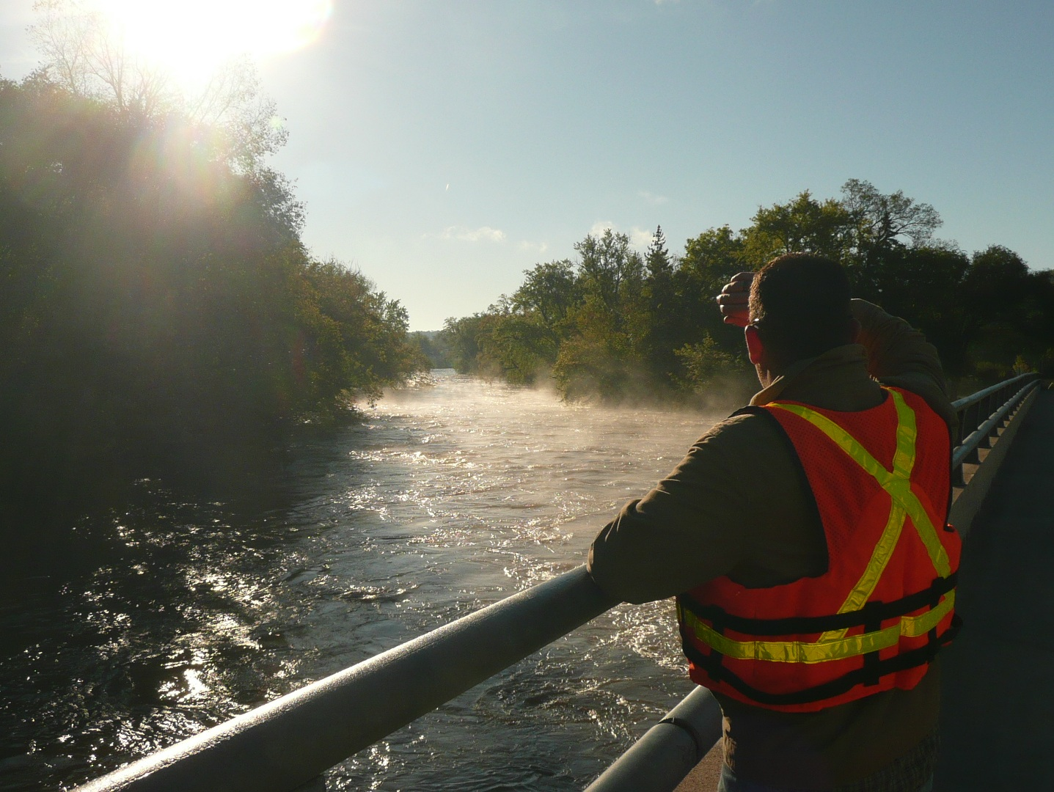
Thank You

Slide 21
Next Steps
  Please turn in your spreadsheet (1 per group)
  Revise Issue Statements
  Revise Recommendations
  Initial Consensus from LWC
  Feedback from Stakeholders
  Final consensus by LWC -November
  Recommendations to Legislature
  Legislative Briefings with Committee

Slide 22
Thanks!
Notes:
For more information and real time monitoring data you can visit this web site.

